Slide 1
Memory Systems Design
  Introduction: 2 Lectures
    Classification of Memory Technology
    Expanding Memory Width and Size
    Memory and CPU Interfacing
  Address Decoding: 3 Lectures
    Full Address Decoding Techniques
    Partial Address Decoding Techniques
    Block Address Decoding Techniques
©Paul Davies. Not to be copied, used, or revised without explicit written permission from the copyright owner.
This lecture may contain animations and is best viewed as a slide show

Slide 2
Memory Systems
Introduction
Memory systems form an integral part of all microcomputer systems and are used to store the following:-
  Program Code – The instructions in your Java or C/C++ code.
  Data – For variables and stack space.
  Firmware – i.e. configuration data and Bios programs, i.e. information or programs that you wish to retain after the system has been switched off and which will be available when the power is reapplied.
Most computer systems thus need a variety of different memory technologies to make a working system and that memory technology can be classified in a variety of ways as shown in the next slide, based on speed, density, cost, size of packaging, ease of use and volatility.

Slide 3
Classification of Random Access Memory Technology
Random access means data can be accessed from any location, i.e. not sequential access
Random Access Memory
Volatile means it does NOT retain its data when power is lost
Random Access Memory
Non-Volatile memory retains data when power is lost
Static (S)ram offers lower storage densities, higher speed and simpler interface than Dram.
Volatile
Volatile
Non-Volatile
Dram has very high storage densities & low cost, complicated interface and timing
Non-Volatile
Dynamic RAM
Static RAM
Dynamic RAM
Static RAM
Mask ROM
MRam & FRam
Mask ROM
Magnetic
DDR Ram
Mask Rom programmed during manufacture
DDR Ram
PROM
UV-EPROM
OTP ROM
UV-EPROM
Rambus
Rambus
Programmable ROM can be programmed by you, once only
NOR Flash EPROM
Flash EPROM
EEPROM
EEPROM
DDR Ram most popular kind of memory in PC Applications
Other types can be programmed, erased and reprogrammed by you.
Rambus see http://en.wikipedia.org/wiki/XDR_DRAM
Notes:
Classification of Random Access Memory (Ram)
We’ll take a more detailed look at all these technologies later in the course and even carry out labs with many of them
Random access memory is split into volatile (loses data when power removed) and non-volatile (retains data)
Non volatile split into many different technologies that have evolved over the years based on a similar architecture that was refined with each generation
Mask Rom (1970’s tech)
First generation of Rom.
Customer provided manufacturer with the data to be stored in the chip
Manufacturers used a generic “base chip design” but provided a custom metallization later (transistor interconnect – the last layer in manufacturing process used to wire transistors together) to store the data
Expensive to produce 1st device, but subsequent chips were “cheap as chips” and were produced with data already inside (thus no need to employ someone to program blank chips)
Time to produce 1st device was 3-6 weeks to allow for a semi-custom design to take place and gearing up for production. After that they rolled off production lines very quickly
Any changes to data requested by customer were expensive and time-consuming as a partial new chip design was required
Laid the foundations for ROM architecture to come
Prom (late 70’s – early 80’s)
A development/evolution of Mask Rom where Metallization layer of Mask Rom was replaced by tiny “fuses” that could be blown by voltages and currents used during programming
First device that could be programmed by user, but only once. If you needed to change data, you needed a new chip
Specialized programming equipment needed but not that expensive.
A Win-Win solution for customer and manufacturer as everyone could use the same “blank” generic chip and produce program them quickly and cheaply
Ultra Violet (UV) Eprom – First erasable/reuseable technology (1980’s-90’s)
Fuses in Prom were replaced with “floating gate MOSFETS” where a charge on the floating gate represents a 0 or a 1 in a cell
Still needed specialized programming equipment and also needed UV light box to erase the device
Device had to be put in a socket on the PCB to allow easy removal for erasure. Sockets were sometimes more expensive than the chip itself
Device could be erased a few thousands times. Lead to whole families of generic chips e.g. 2764, 27128 (64k and 128k bit devices)
Electrically Erasable (EE) Prom (90’s – today)
Modification to UV-Eprom architecture to allow Floating gate Mosfets to be erased “in-situ” using large electrical fields/voltages rather than UV light
Devices also had internal circuitry to generate voltages required for programming/erasing
Devices could thus be erased and programmed “in the field” allowing the sort of “over the net” updates we take for granted today
Each single but cell required two MOSFETSs, so initially density was lower than for previous generation UV-Eprom
No need to put devices in expensive sockets and no need for specialized programming/erasing equipment
Beauty of this technology was that it permitted “byte-by-byte” erase and program operations (most other technology require the whole chip to be erased and programmed just to make a single byte change). This is why it is still used today but Flash is more popular for large density storage with faster erase/program cycles
Life of device was several thousand erase/programs cycles
Flash (00’s to present)
Development of EEProm where single cell erase/program feature was replaced by sector/block/chip operations
Due to layouts, huge density now possible. This is the backbone of the computer industry for ROM type of applications, market worth billions $$$ world wide
Applications include firmware (e.g. laptop BIOS, Cell phones etc) , SDCards, USB thumb drives and more recently Solid State Disk drives (SSD)
Mram and Fram are immerging technologies with Niche applications (at the moment). Expensive compared to say Flash, but have the potential to replace all other memory technology including Sram and Dram
Volatile technology includes
Static Ram: (Sram)
Usually 6 transistor cells per bit. Relatively high power but fast. Data stored in a flip-flop arrangement inside 6 transistors
Limited storage capability, used most often in caches and other high speed devices, but many small 8 and 16 microcontrollers use them almost entirely for limited amounts of memory due to simplicity of interfacing
Cost per bit is expensive compared to Dram
Dynamic Ram (Dram)
Usually based on 1 transistor and 1 capacitor per bit
Charge stored on capacitor represent a ‘0’ or a ‘1’
Backbone of the industry. Used in all PCs and Laptops, servers, graphics, cell phones etc for large capacity memory
Cost per bit very low
Complex interfacing and timing make it only worthwhile for large memory applications
Charge on capacitor leaks away so needs constant refreshing (more complexity) in hardware
RamBus
When Intel and AMD were fighting it out for CPU supremacy in the 90’s, Intel jumped into bed with Rambus Inc which was an alternative type of Dram in smaller packaging (fewer pins) with a high speed byte wide interface
AMD went with conventional Dram from lots of other manufacturers
Rambus produced open source design which sounds attractive BUT…
Rambus Inc, charged a license for using the tech, which made Intel based PCs uncompetitive in the “cut throat” PC market where profit margins are wafer thing, so Intel eventually abandoned it and went with conventional Dram
RamBus tech was most famous for its application inside games consoles like Sony Play Station 2/3 and Nintendo 64

Slide 4
Classification of Sequential Access Memory Technology
Sequential Memory
Random Access Memory
Volatile
Volatile
Non-Volatile
Non-Volatile
SPI Ram
DDR Ram
I²C RAM
Dynamic RAM
NAND Flash EPROM
Flash EPROM
I²C ROM
SPI ROM
Dynamic RAM
DDR Ram
Sequential devices are non-randomly accessible and are characterised by different types of external interface: An access is made by first writing an address to them, they respond with data from successive locations with each subsequent read/write access:
Low speed (CPU cannot execute programs from them directly)
Tiny packaging with few external pins (relative to random access devices) when a serial bit-stream interface is used.
Protocol Intensive: Needs a H/W controller and a S/W to read/write to them: Useful as secondary or backup storage
Notes:
Some memory technology is designed to be accessed (read/write) sequentially.
This is attractive because devices and packaging can be made physically very small for dense data applications (e.g. inside cell phones) and thumb drives.
Such technology generally uses either IIC or SPI serial interfaces (for the tiniest devices) which require a dedicated controller chip

Slide 5
Typical Random Access Memory Chip - External Interface
Memorize these
Address Bus – A collection of ‘N’ address lines A₀ - A_{N-1} used to select 1 of 2^{N} separate memory locations within the chip - comes from CPU.
‘N’ Locations Address(0 to)
1 2 00000001
2 4 00000003
8 256 000000FF
10 1024 (1k) 000003FF
13 8192 (8k) 00001FFF
16 65536 (64k) 0000FFFF
20 1Meg 000FFFFF
24 16Meg 00FFFFFF
32 4Gig FFFFFFFF
‘N’ Bit Address Bus
Address Bus
A₀ – A_{(N-1)}
Memory Chip
Data Bus – A collection of ‘M’ data lines
D₀ - D_{M-1} used to transfer data to/from chip/cpu.
‘M’ Bit Data Bus
Data Bus
D₀ – D_{(M-1)}
Data Bus will be bi-directional if the device supports reading and writing. Tri-state outputs turned off when not selected or when writing.
Total Storage = M * 2^{N} bits
OE – Output Enable (If present). Controls tri-state outputs on Data bus. Used to turn off the data bus outputs between memory accesses to different memory chips in fast systems. Overlap of output buffers in two chips could burn out both chips. Can be tied to CS or logic 0 if required.
CS – Chip select (active low in this case). There may be more than 1 chip select signal present on the chip in which case all must be active for device to respond.
CS
R/W
OE
R/W – Read/Write (if present). Controls data transfer direction.

Slide 6
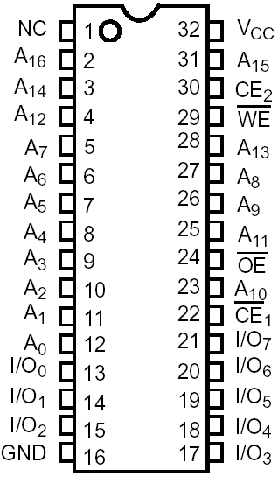
A Typical Random Access Memory Chip made by Cypress
Question 1
How many individually addressable memory locations does this device have and what is its range of addresses?
Solution 1
There are 17 address lines A0-A16 thus the device has 2¹⁷ locations or 131,072 (128k). Range of addresses is from [0,0000,0000,0000,0000]₂ to [1,1111,1111,1111,1111]₂ or [00000-1FFFF] ₁₆
Question 2
What is the total bit storage capacity of this device?
Solution 2
There are 8 data lines I/O₀-I/O₇ so the total storage is 131,072 (128k) bytes or 1,048,576 bits of storage (1Mbit), we describe the chip as a 128k x 8 device
Question 3
How many chip select and output enable lines does this chip have and what is their active state?
Question 4
What does WE mean

Slide 7
Building Memory Systems by Increasing Data Bus Width
Sometimes you want a memory system with a certain “data bus width” but you can’t buy chips with that many data pins. For example, how could we make a 32k x 16 bit memory system from 32k x 8 bit memory chips i.e. chips with 8 data lines?
Simply put 2 devices to work together in parallel, each dealing with 8 of the 16 data bits. Each chip is connected to 15 address lines (2¹⁵ = 32k) labelled A₁₄-A₀
Common Address Bus + Control Signals
Split/Merged Data Bus
What is total Address Range?
Lower 4 bit device
[D₇..D₀]
from outside
[A₁₄..A₀]
32k x 8
[D₁₅..D₀] outside
[A₁₄..A₀] on Chip
CS
R/W
OE
[D₇..D₀] on chip
Merge/split of 16 bit CPU data bus into two 8 bit memory chip buses. Both memory chips are enabled at the same time to contribute 8 bits each to a 16 bit transfer.
CS
R/W
OE
[D₁₅..D₈]
from outside
CS
R/W
OE
32k x 8
[A₁₄..A₀] on Chip
Upper 4 bit device
[D₇..D₀] on chip

Slide 8
Increasing Address Range
How could we make 128k bytes of memory using 64k byte (64k x 8 bit) chips so that there are no gaps in the address range, i.e. the memory looks like a contiguous 128k block.
Each 64k byte chip will use 16 address lines, A₁₅ – A₀ since (2¹⁶ = 64k).
A 128k byte block requires 17 address lines A₁₆ – A₀ since (2¹⁷ = 128k).
Solution: Use the unused highest order address line (A₁₆) to select between each 64k chip.
Question: What about a 256k memory system or a 512k or a 1Meg system based on 64k chips?
What address range does this chip respond to ?
Chip selected when A16 = 0
What is Total Address Range?
[D₇..D₀]
64k x 8
[A₁₆..A₀]
64k x 8
[D₇..D₀]
[A₁₅..A₀] on Chip
CS
R/W
OE
Both memory chips have connections to same Data lines, but only 1 chip is enabled at any one point in time based on value of A16
A₁₆
R/W
Chip selected when A16 = 1
OE
CS
R/W
OE
[D₇..D₀]
Note Inverter: The value of A16 ( 0 or 1) used to select one 64k memory chip or the other
64k x 8
64k x 8
[A₁₅..A₀] on Chip
What address range does this chip respond to ?

Slide 9
Typical simple 8-bit CPU Interface: Motorola 6811
How are these signals affected by a program?
Address Bus – 16 bits = 64k address space
[0000 – FFFF]. An address is issued by the CPU whenever it wishes to access an external memory location (off chip) or IO device
Total address space composed of external as well as internal (built in memory and IO) space.
A₀ – A₁₅
‘16’ bit Wide Address Bus
Data Bus – Driven by the CPU when it wishes to write to a memory/IO location. Read by CPU when it wishes to read the contents of memory location
D₀ – D₇
‘8’ bit wide Data Bus
R/W
R/W
R/W – Controls direction of data transfer
Logic 1 means CPU is reading from Memory/IO.
Logic 0 means CPU is writing to Memory/IO
E (Enable) low when the address is Valid and Stable, i.e. a transfer – read or write - can now take place
E
E
6811
Most 8 Bit Microprocessors use Synchronous data transfers for simplicity. That is:-
The CPU issues a valid address and the memory system has to respond to the read/write request within a specified time period (measured in clock cycles) otherwise the transfer will fail. That is, there is no handshake back from the memory to the CPU to indicate if/when the memory has performed the requested operation. The system designer has to calculate the ‘read’ and ‘write’ access and cycle times of the memory to make sure it is compatible with the CPU clock speed. This is a detailed subject for a later lecture.
Notes:
It’s important to remember that the CPU automatically drives the Address bus as it executes programs.
The Address bus is usually a reflection of what is held by the CPU’s Program counter, so it auto-increments as program instructions are fetched and executed from memory, but other instructions may also force other addresses onto the address bus, e.g. an instruction that asks the CPU to read/write a memory location or an IO device will result in the address of the memory or IO device appearing on the address bus for the duration of the read/write
The Data bus is similarly driven by the CPU and it’s direction is changed based on whether it is reading (such as Instruction machine code or Data) or writing (e.g. saving data to memory or pushing data on the stack)

Slide 10
Typical 16k Byte Memory Block Interfaced to the 6811
Chip selects: CS0/CS1 are derived from an Address Decoder circuit which is a function of the unused address lines of the CPU. In this case, A13-A15 . See next lecture
OE’s may be connected to CS or ground in a simple system.
E
Address
Decoder
CS0
Address
Decoder
CS1
A13-A15
R/W
OE
OE
WE
WE
Address decoder is generally a function of the unused address lines coming from CPU, i.e. those address lines that are not connected directly to memory
CS
CS
8k x 8
8k x 8
D0-D7
D0-D7
A0-A12
A0-A12
D0-D7
A0-A12
Lower 13 Address lines direct from CPU. (2¹³ = 8k)
Two 8k byte devices working in series to give 16k bytes

Slide 11
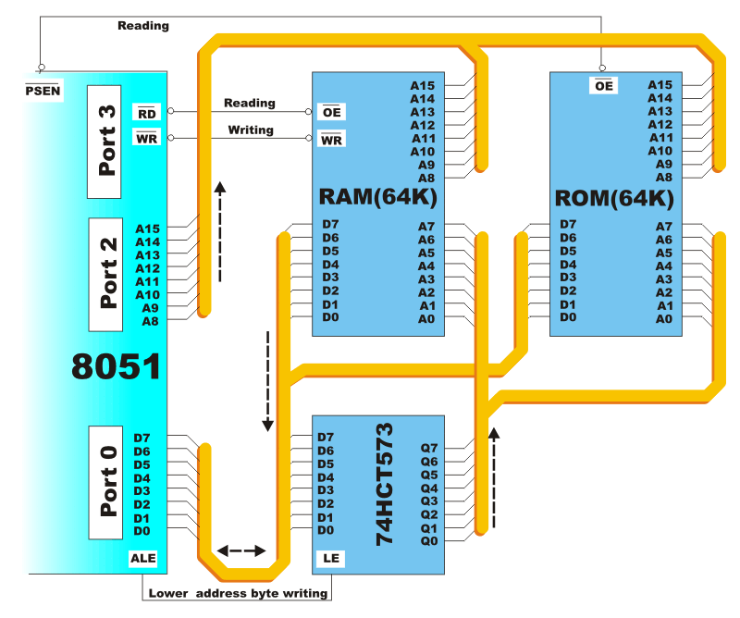
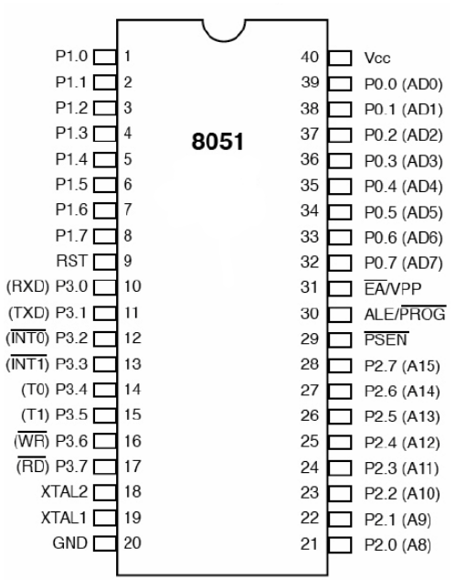
Typical 8051 Expanded External Memory Interface
8051 has some internal Rom/Ram, but can be expanded with 64K of each, but you lose the parallel ports P0, P2 and some bits of P3.
8051 has a combined external data and address bus. An Address Latch Enable (ALE) signal is produced on one half of the clock so that address can be latched externally. Data is transferred on the other half of the clock or the same pins.
PSEN – Program Store Enable i.e. external (ROM) memory enable.
Typical external Rom/Ram interface shown below
Latch

